Slide 1
B Positive: A Database for Blood Banks, Patients and Donors
By: Cody Hutton, Isabelle Harbuck, Whitson Sutherland
Group 5

Slide 2

Idea
The Purpose of this project is to create a database for patients and hospitals to find matches for blood transfusions, and to make it easier for them to display, update and delete information.
The targeted user of this database is individual persons, to third party companies, to full hospitals.
Patients, doors and hospitals will be able to access information from a web-based application.
Data will be populated from users and from ourselves.

Slide 3
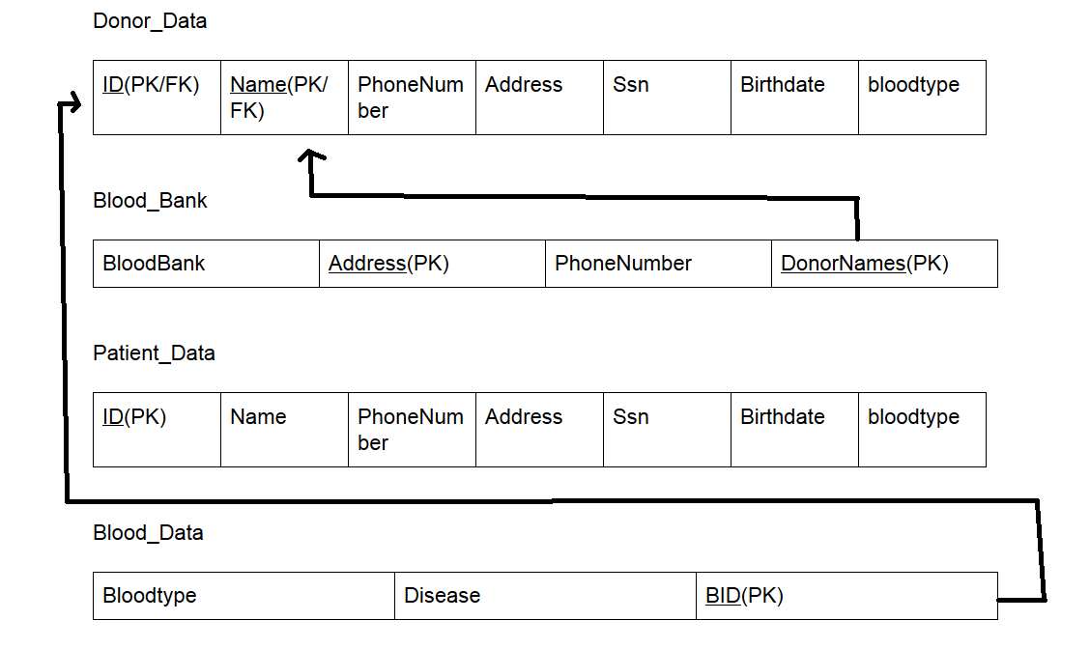
Schema
The schema is fairly simple as the tables Donor_data and Patient_data feature similar attributes but have different foreign and primary keys. The tables are used to store data for the donor, and view data for the patient. The blood_bank table stores information concerning the companies holding the blood and the donor’s names who donated. Finally the blood_data table stores information about the blood donated such as the bloodtype and any disease it may contain. It also has a blood ID labeled BID.
The schema shows our two foreign key connections: Blood_Data’s BID is a FK to donor_data’s ID to match blood to donor. & Blood_Bank’s DonorNames is a FK to Donor_Data’s Name keep storage of donor to blood bank they donated to.

Slide 4
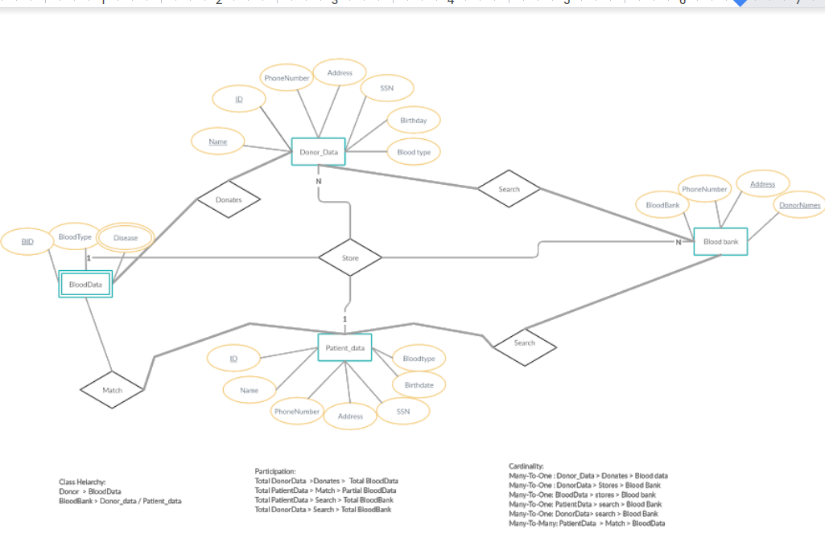
ER Diagram
The ER diagram shows a great representation and connection of our database tables. The donor_data searches the blood_bank, which the patient_data also has availability to. Both patient and donor data have attributes stored in Blood_data and Blood_bank. Finally Donor_data donates to blood_data which patient_data matches to find correct blood types

Slide 5
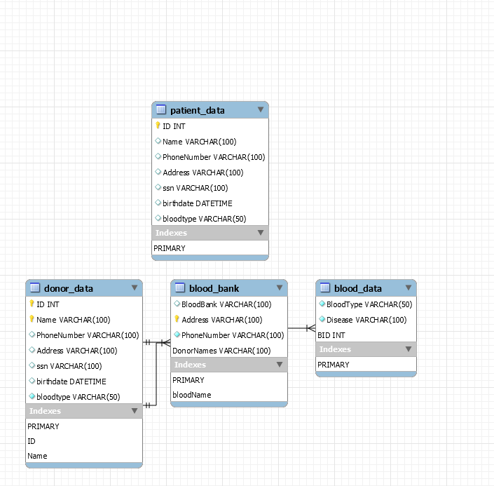
UML
The UML shows our 4 main tables: Patient_data, Donor_data, Blood_bank and Blood_data.
The UML also shows the primary keys used as as the data types of each table. Note patient_data doesn’t have a connection to the other tables as it’s more of a way for patients to view their own information.

Slide 6
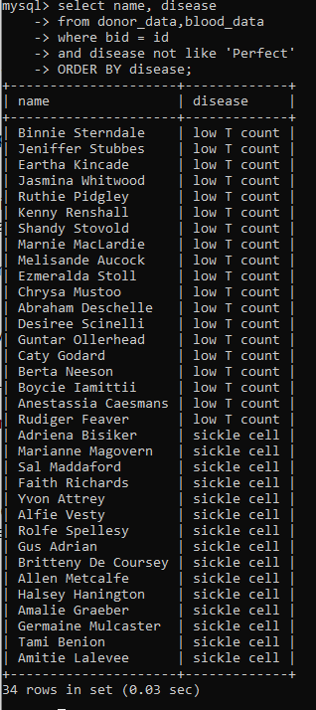
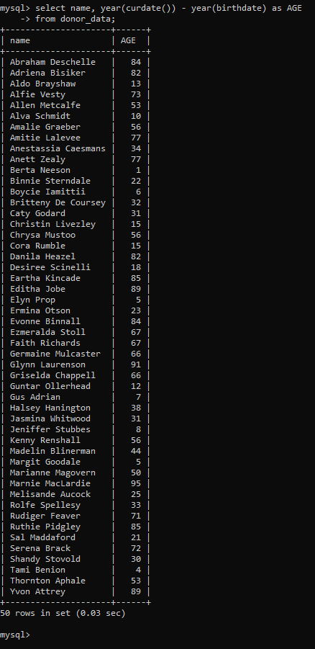
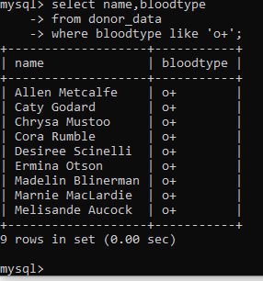
Sample Queries
Starting from the left: Q1: retrieves the bloodtype of donors with o+ Q2: retrieves the donors with marked blood Q3: retrieves the age of donors (dummy data generated)

Slide 7
Primary Function
Display information for patients, donors and blood banks.
Update blood banks phone number.
Allow patients and donors to delete their information from the database.
Allow patients to insert themself into the database.
Allow for patients to query the database to find a match for a blood transfusion. This function will make sure the blood isn't diseased and that their blood types match.

Slide 8
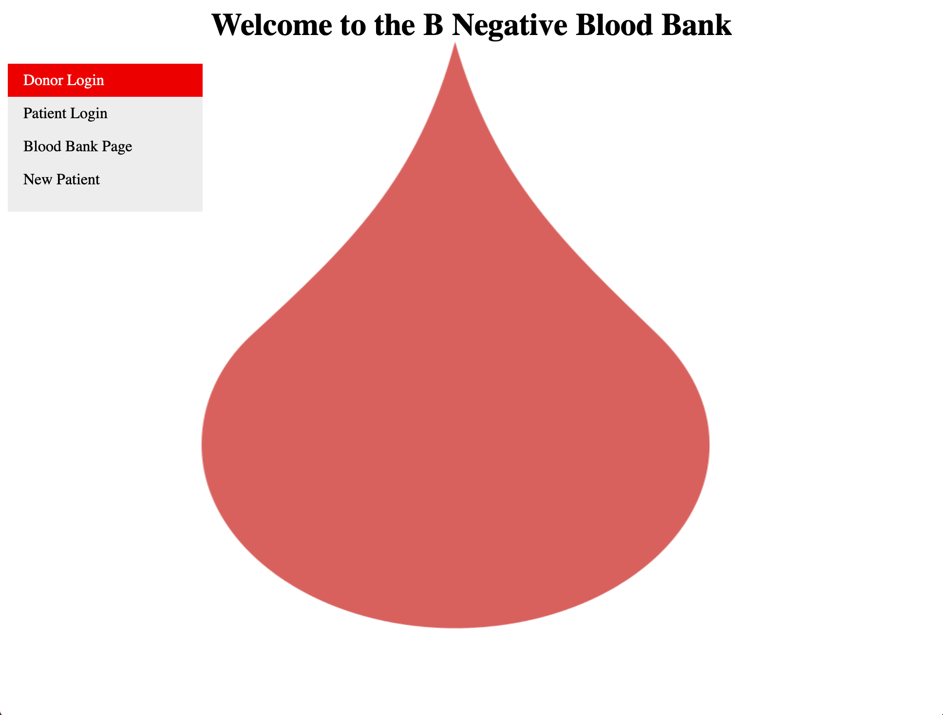
Scope of Web-based Application
The purpose of the web-based application is to make it easy on the user to display, delete, update and query the database.
We tried our best to make it as easy as possible on the user with fun graphics to make it more visually appealing.

Slide 9
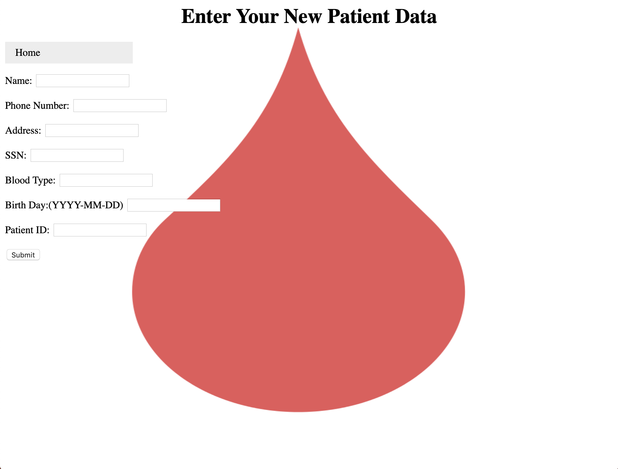
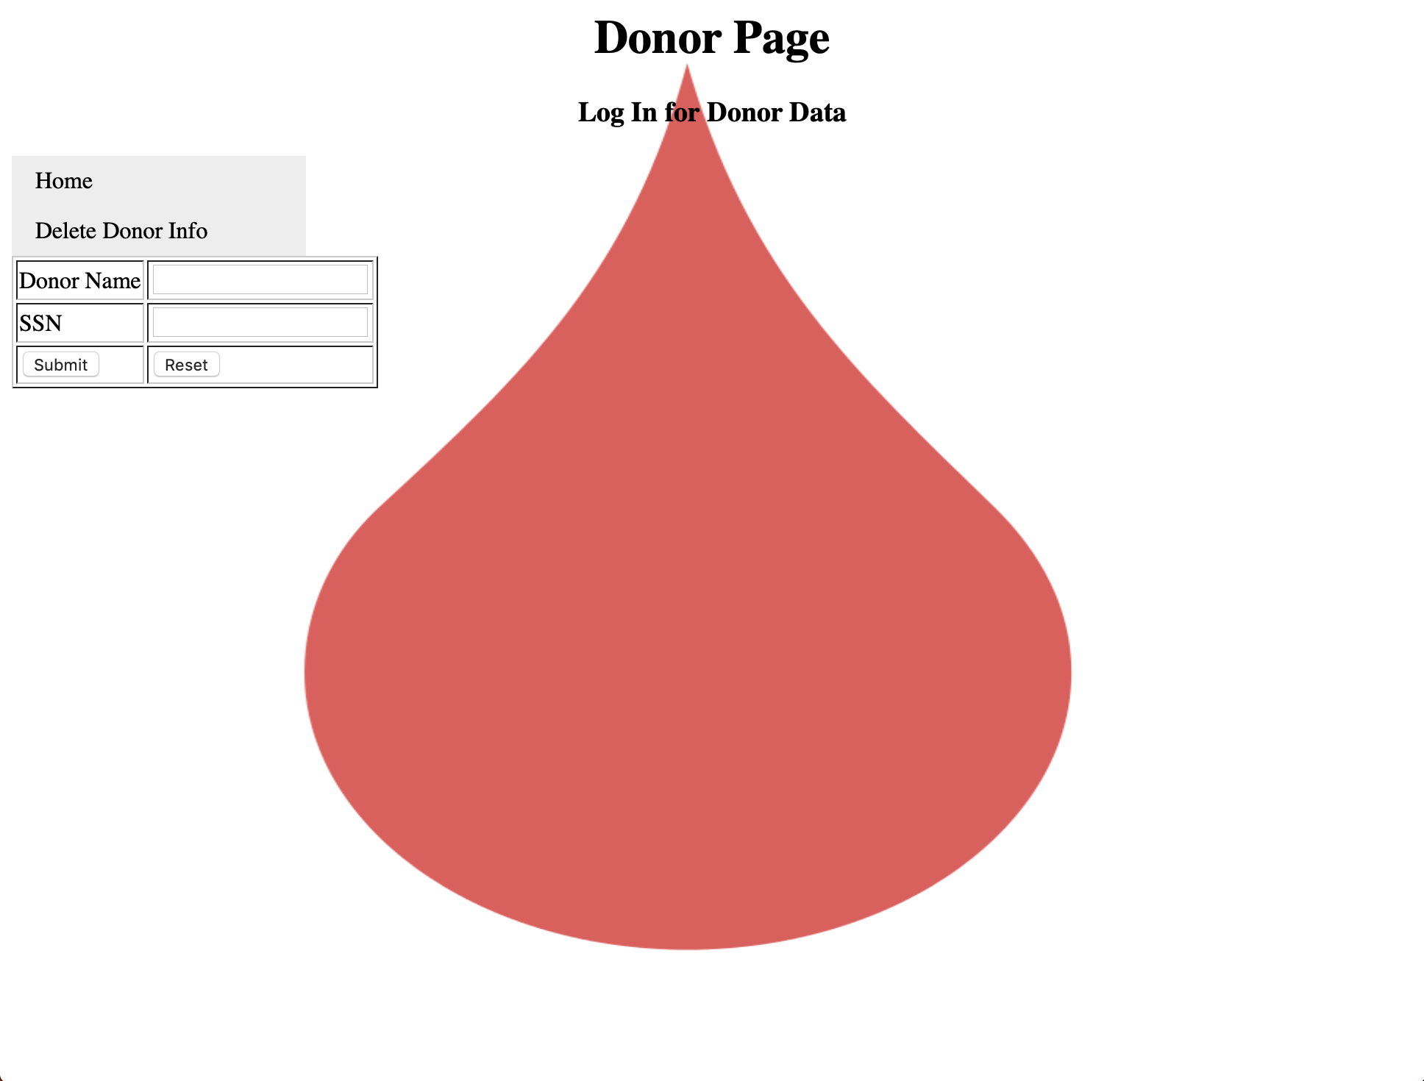
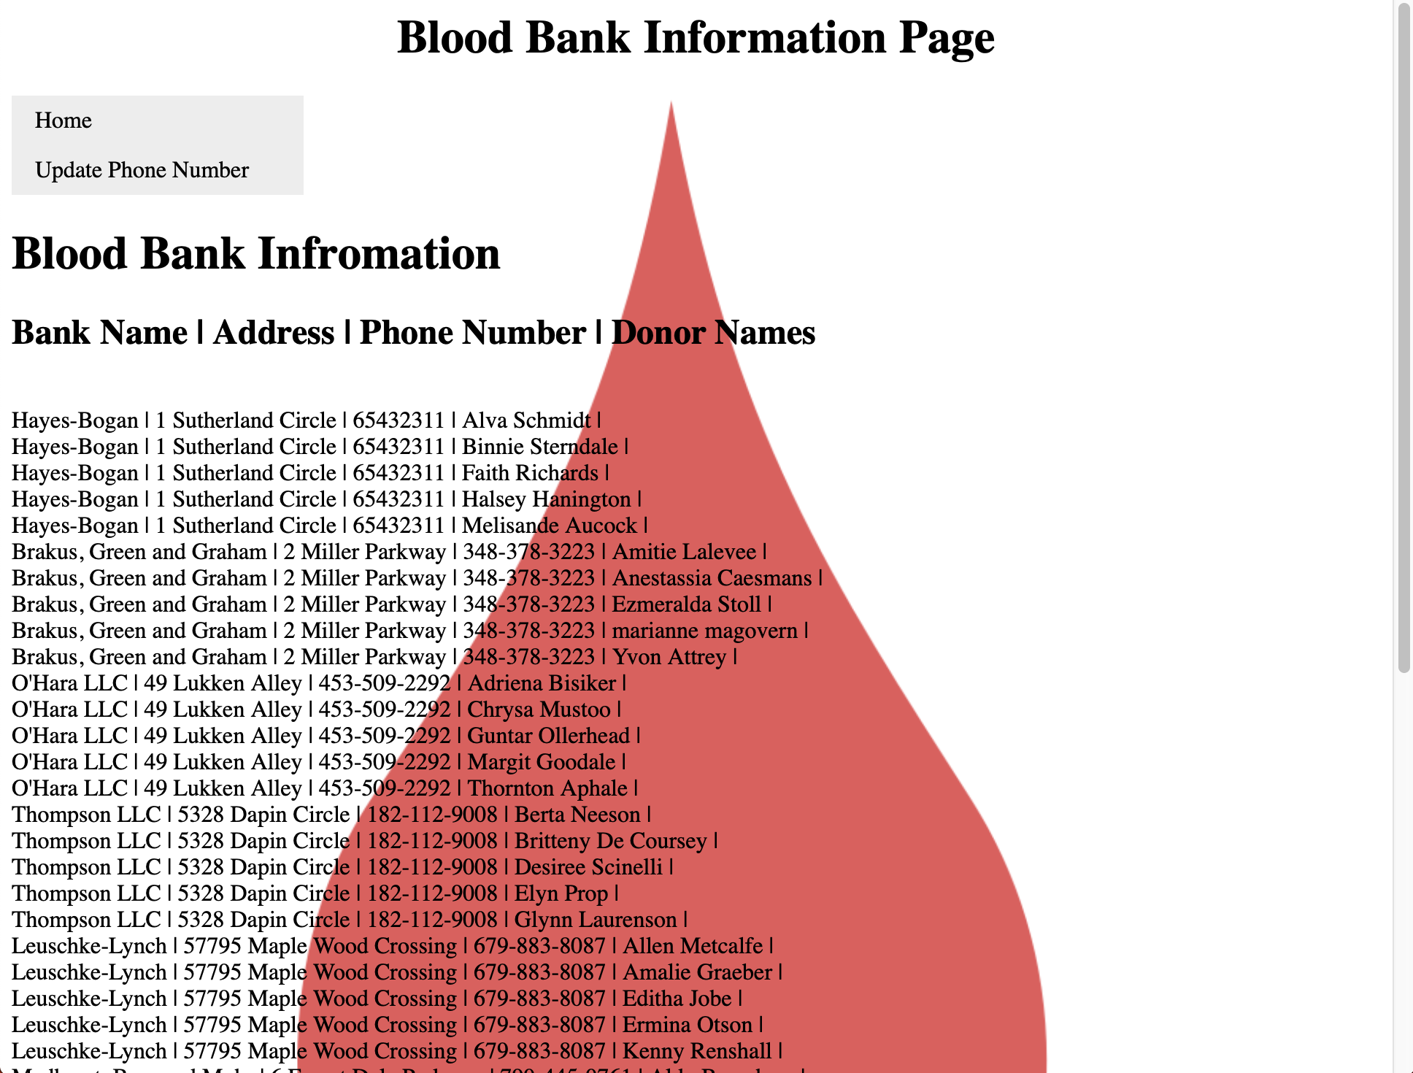
Samples of the Final GUI

Slide 10
Technologies Used
MySQL workbench (for the database)
Terminal (for the database)
Creatively (for the ER Diagrams)
Xampp (for the website code)
Mockaroo.com (for the dummy data)

Slide 11
Group Member Contributions
Cody Hutton Made ER diagram/relation, created database, helped on HTML & final report.
Isabelle Harbuck- Wrote most of the report, contributed to the queries, created the presentation.
Whit Sutherland - Wrote the code for the web applet (html & php) and created the demonstration video.

